Slide 1

Atal Bihari Vajpayee-
Indian Institute of Information Technology and Management Gwalior
Computer Graphics Lab : 02
Vector Graphics & Raster Graphics
Instructor – Dr. Sunil Kumar
Assistant Professor @ Dept. of Information Technology, ABV-IIITM Gwalior
Teaching Assistants (TAs)
Mehr Aliah, Sheel Patel, & Pranav : MON : 2 pm – 4 pm | Group-02
Anushka Agarwal, Radhika, and Riya : FRI: 9 am – 11 am | Group-01

Slide 2
Objective of this lab
To understand the concepts of Vector Graphics and Raster Graphics, compare their characteristics, and study their mathematical representation, storage mechanisms, and conversion techniques.
Converting one form of the graphics to the other form.

Slide 3

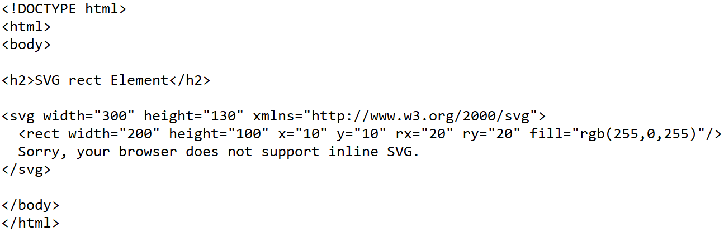
Demo Assignment – 00
(Vector Graphics)
SVG Example:
Output: SVG rect element
https://www.w3schools.com/graphics/svg_intro.asp

Slide 4
Assignment – 01
(Vector Graphics)
Write the .html code (Assignment-00) in Notepad and save it as .html file.
Click on it to open or to show the output
Do the following modification and observed the output graphics:
  Generate the graphics for rx = 0 and ry = 0
  Generate the graphics by changing rgb(r_value, g_value, b_value)
    rgb(255, 0, 0) = red
    rgb(0, 255, 0) = green
    rgb(0, 0, 255) = blue
    rgb(255, 255, 0) = ……..
    rgb(0, 255, 255) =
    …
    rgb(x, y, z)

Slide 5


Assignment – 02
(Vector Graphics)
Write the .html code to generate the following vector graphics:
Centre at (100, 100) and Radius = 10
Color code : (100, 0, 100)
Centre at (200, 200) and Radius = 100
Color code: (100, 100, 100)

Slide 6
Assignment – 03
(Vector Graphics)
Write the .html code to generate the following vector graphics:
SVG Line
SVG Polyline

Slide 7
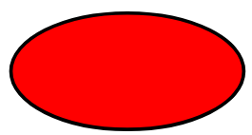
Assignment – 04
(Vector Graphics)
Write the .html code to generate the following vector graphics:
SVG Ellipse
SVG Polygon

Slide 8
Assignment – 05
(Vector Graphics)
Write the .html code to generate the following vector graphics:
This is Amazing !
SVG Text

Slide 9

Assignment – 06
(Vector Graphics)
Write the .html code to generate the following vector graphics:

Slide 10

Assignment – 07
(Vector Graphics)
Download and Install Free trail version of Adobe Illustrator and create the vector graphics for the below raster graphics:
Use AI Illustration Generator to execute the same

Slide 11
Thank you !

